Slide 1

Stat 450 Project
Customer Personality Analysis
By Luis, Greg, Sean, Evan

Slide 2
Background and Introduction
Businesses serve large customer bases
Being able to group customers can help save time and money
Enables businesses to target ads and receive business insight
Grouping without a preconceived structure is ideal for Cluster Analysis
Cluster Analysis: variables are grouped into clusters based upon similarities/distances

Slide 3
Table of Contents
Dataset
Exploratory Data Analysis
Research Question #1
Statistical Technique (Clustering)
Research Question #2
Statistical Technique (Manova)
Results and Conclusion

Slide 4
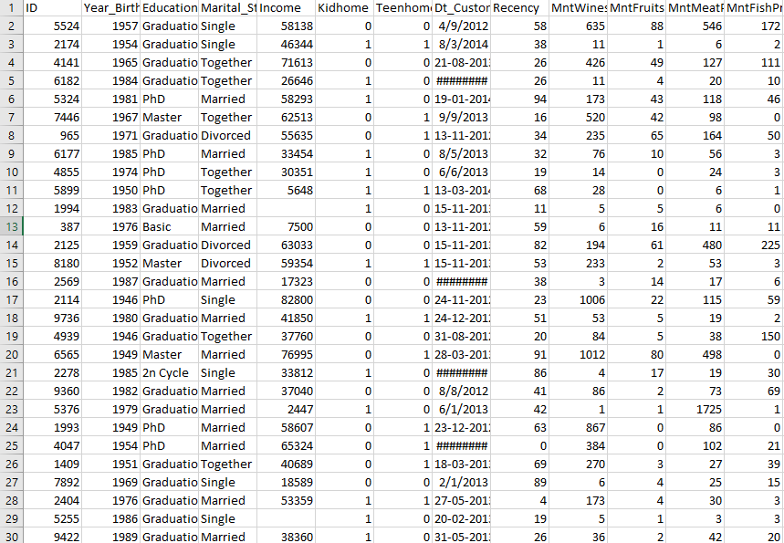

Dataset
Dataset is from Kaggle.com
Customer Personality Analysis
29 variables divided into 4 categories (People, Products, Promotion, Place)
2,240 observations
Notes:
https://www.kaggle.com/datasets/imakash3011/customer-personality-analysis?datasetId=1546318&sortBy=voteCount

Slide 5
Dataset Information People
People
ID: Customer's unique identifier
Year_Birth: Customer's birth year
Education: Customer's education level
Marital_Status: Customer's marital status
Income: Customer's yearly household income
Kidhome: Number of children in customer's household
Teenhome: Number of teenagers in customer's household
Dt_Customer: Date of customer's enrollment with the company
Recency: Number of days since customer's last purchase
Complain: 1 if the customer complained in the last 2 years, 0 otherwise

Slide 6
Dataset Information Products
Products
MntWines: Amount spent on wine in last 2 years
MntFruits: Amount spent on fruits in last 2 years
MntMeatProducts: Amount spent on meat in last 2 years
MntFishProducts: Amount spent on fish in last 2 years
MntSweetProducts: Amount spent on sweets in last 2 years
MntGoldProds: Amount spent on gold in last 2 years

Slide 7
Dataset Information Promotion
Promotion
NumDealsPurchases: Number of purchases made with a discount
AcceptedCmp1: 1 if customer accepted the offer in the 1st campaign, 0 otherwise
AcceptedCmp2: 1 if customer accepted the offer in the 2nd campaign, 0 otherwise
AcceptedCmp3: 1 if customer accepted the offer in the 3rd campaign, 0 otherwise
AcceptedCmp4: 1 if customer accepted the offer in the 4th campaign, 0 otherwise
AcceptedCmp5: 1 if customer accepted the offer in the 5th campaign, 0 otherwise
Response: 1 if customer accepted the offer in the last campaign, 0 otherwise

Slide 8
Dataset Information Place
Place
NumWebPurchases: Number of purchases made through the company’s website
NumCatalogPurchases: Number of purchases made using a catalogue
NumStorePurchases: Number of purchases made directly in stores
NumWebVisitsMonth: Number of visits to company’s website in the last month

Slide 9

Exploratory Data Analysis

Slide 10
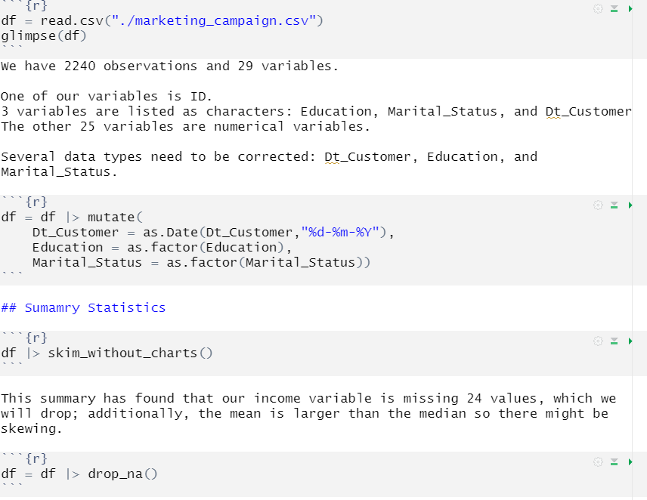
Exploratory Data Analysis
Looked for missing data and removed observations with missing data
Correct date formats
Updated Marital Status and Education to be factors/categorical variables
Notes:
Pictures are subject to change, placeholders for now

Slide 11

Data Visualization
Notes:
Once again pictures are subject to change

Slide 12
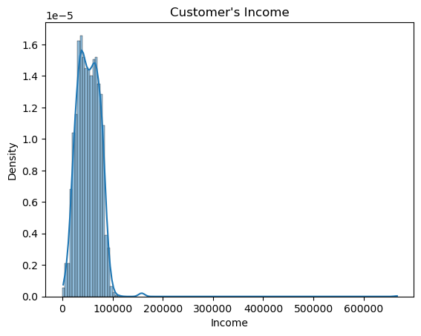
Income
Outliers over 200,000
Could possibly impact the model
Set threshold to be 300,000

Slide 13
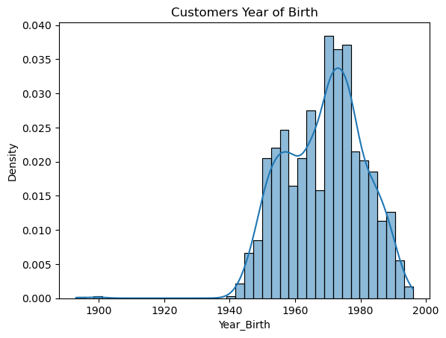
Year of Birth
Outliers
Consider those born before 1930 to be outliers
Converted to Age within dataframe

Slide 14
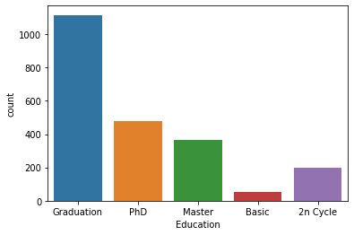
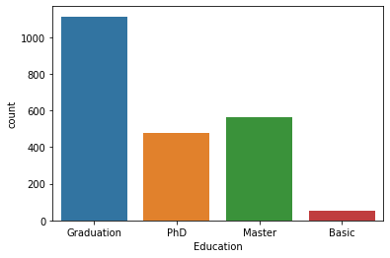
Education

Slide 15
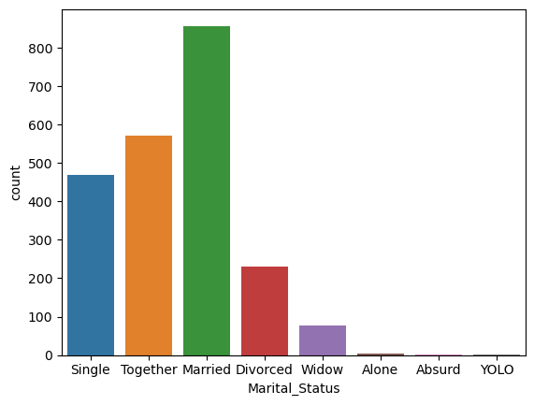
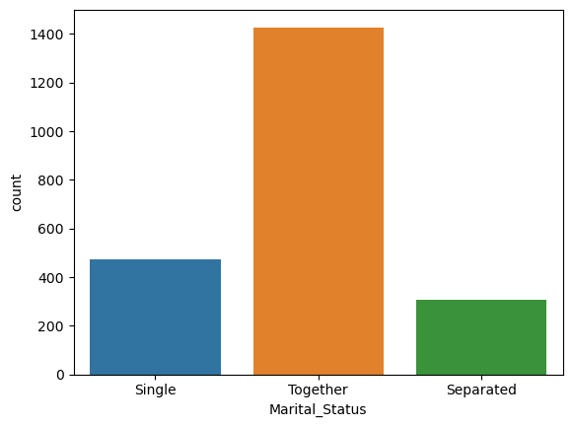
Marital Status

Slide 16
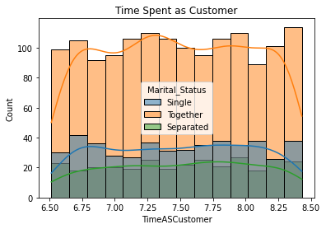
Time Spent as Customer with Marital Status

Slide 17
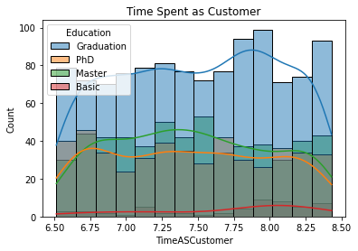
Time Spent as Customer with Education

Slide 18
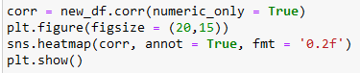
Correlation Exploration
EDA continued.

Slide 19
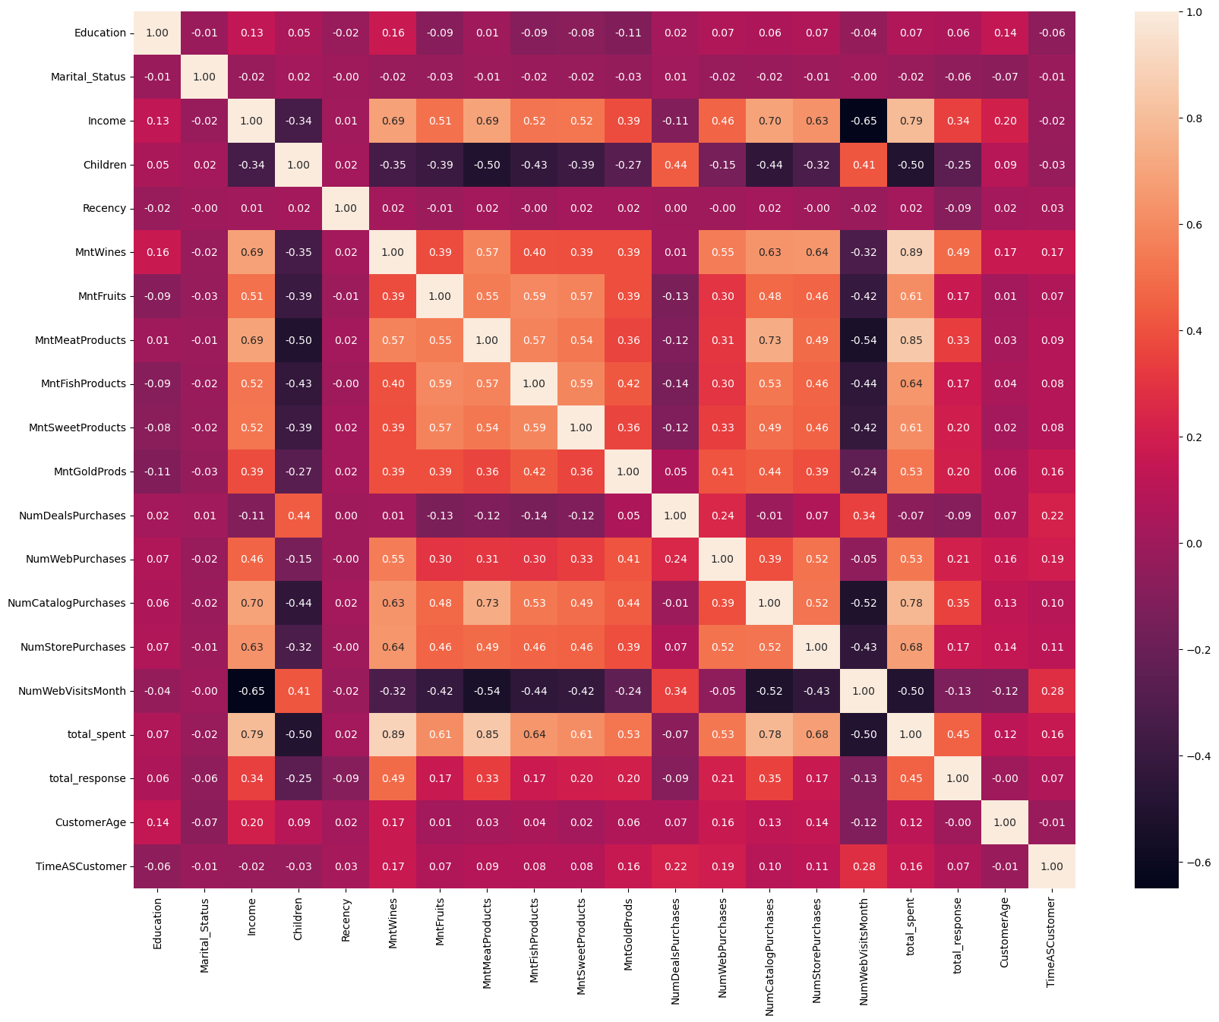
Correlation Matrix
Some highlights:
Website visits and income -0.65
Income and total spent on groceries 0.79

Slide 20

Research Question:
How can we group customers within the dataset?
Notes:
SUBJECT TO CHANGE COULD DO MEAT PRODUCTS COULD DO PROMOTIONS, BASICALLY THIS CHANGES

Slide 21

2. Our method:
Clustering

Slide 22
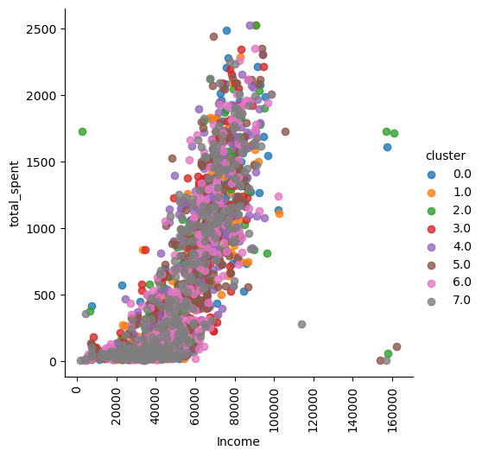
K Means Clustering
Trying to show the different groups of customers based off of the variables for proper customer segmentation
Here we are focusing on the relationship between total spent and income
K Means Clustering is able to scaled, and since we have a large dataset it works
Also works with our binary variables within our dataset.

Slide 23
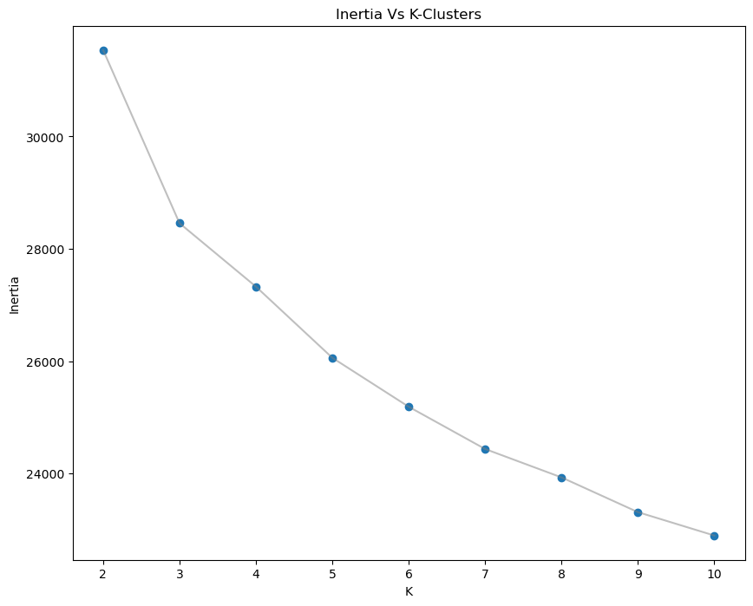
Choosing Optimal Number of Clusters
Method 1: Elbow Method
Plotting the sum of squared distances (SSE) of each point to its assigned cluster centroid against the number of clusters.
When the SSE curves starts to form an “elbow” on the graph usually marks the optimal number of clusters
Here 3 is our optimal number of clusters
Notes:
For sake of time if too long we can remove this slide

Slide 24
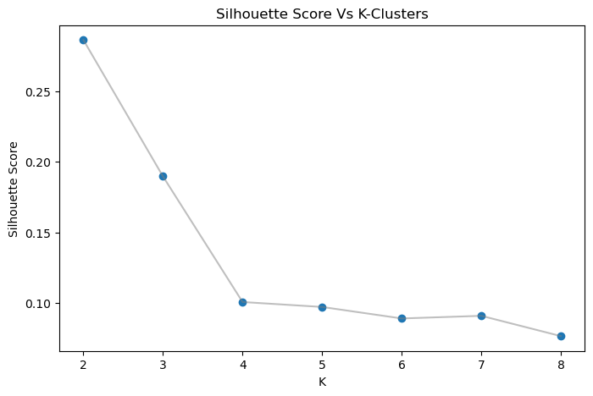
Choosing Optimal Number of Clusters
Method 2: Silhouette Score
Measures how well a data point fits into a cluster and how well they are separated from one another
Silhouette score ranges from -1 to 1, with higher values indicating better clustering performance
Here 2 is our optimal amount of cluster so we will proceed with two.
Notes:
For sake of time if too long we can remove this slide

Slide 25
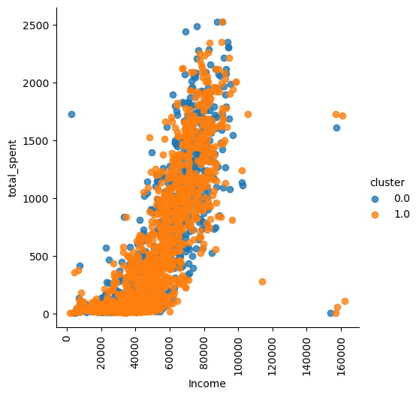
K Means Clustering - 2 Clusters
Diagram showing the relationship of total_spent and income between the two clusters

Slide 26
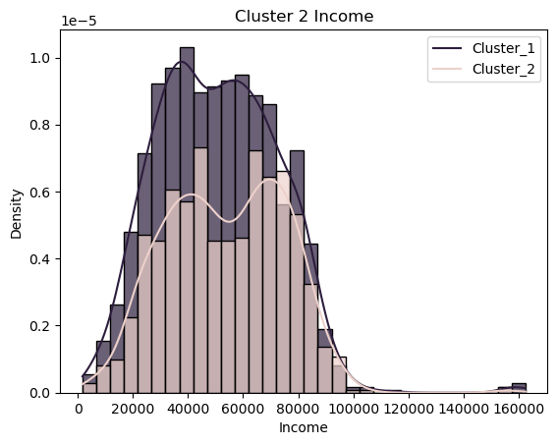
Income Cluster Comparison
Diagram reveals Cluster 2 has a much more smaller density of Income when compared to Cluster 1

Slide 27
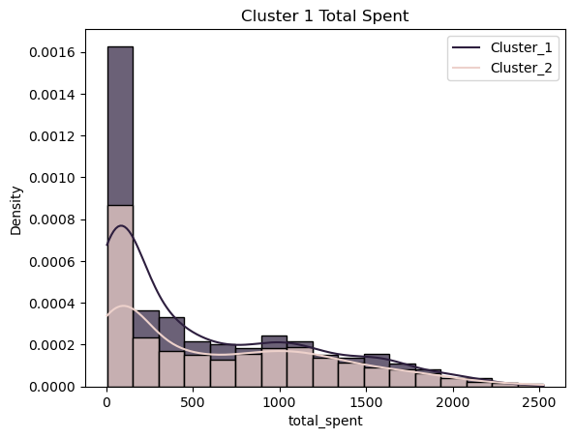
Total Spent Cluster Comparison
Diagram reveals Cluster 1 has a much larger Total_Spent density when in between 0 and 500, and everything past is slightly larger than Cluster 2’s density

Slide 28
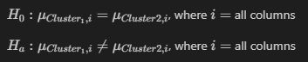
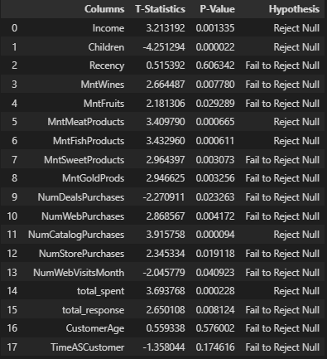
Unpaired T-test
T-test between the numeric columns of Cluster 1 and Cluster 2 in order to check for differences between the two to validate our results using alpha = 0.05
Only Income, Children, Meat, Fish, Catalog Purchases, and Total Spent rejected the null hypothesis

Slide 29
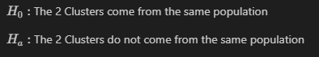
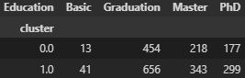
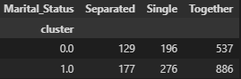
Chi Square Test of Homogeneity
Instead of numeric variables for the T-Test, we wish to test whether or not the categorical variables come from the same population, meaning if there is a difference between the two.
Using alpha = 0.05

Slide 30
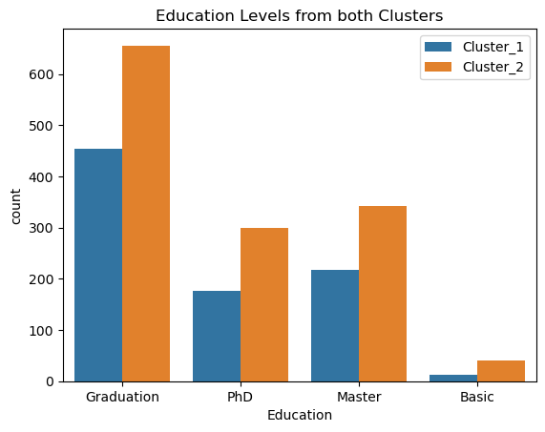
Chi Square Test of Homogeneity Education
We received a value of p = 0.061 and since it is larger than our alpha = 0.05 we fail to reject the null hypothesis and would say the data comes from the same population
P-value of = 0.061 near borderline
Some possibilities include the number of observations were similar in both of the clusters
Notes:
P VALUE

Slide 31
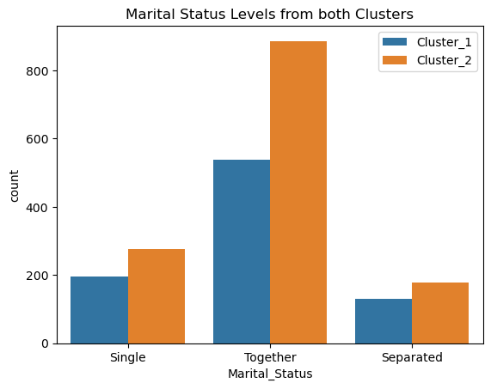
Chi Square Test of Homogeneity Marital Status
We received a value of p = 0.176 and when compared to our alpha value of 0.05, we would fail to reject the null hypothesis since our p-value is larger
We cannot conclude that the data comes from differing populations

Slide 32
Cluster Comparison Findings
Cluster 1
Income is greater than Cluster 2
Less children
Slightly less Education level
Spent more on Meats and Fish
More catalog purchases
Total spent greater than Cluster 2
Less people who were single, together, and separated
Cluster 2
Income is smaller than Cluster 1
More children
Slightly more Education level
Spent less on Meats and Fish
Less catalog purchases
Total spent was smaller than Cluster 1
More people who were single, together, and separated
Notes:
Could possibly put into a table

Slide 33
Answer to our Question and Further Analysis
Now that we found the differences between the two customers, we have found a way to answer our original research question of how to group the customers. We could group the customers by Income, Children, Meat, Fish, Catalog Purchases, and Total Spent.
This effectively answers our first research question of how could we segment customers. For example, we could say that the company should target those with less children since they spent more on meats and fish, and had a higher total spent.
Additionally, as a team we were curious on how we could quantify the effect of some of the variables on the two most important variables, Income and Total Spent, therefore we wanted to test the variables we thought were originally going to be most important, Education and Number of Children
Notes:
I CAN TURN THIS SLIDE INTO BULLET POINTS IF IT LOOKS TOO WORDY.

Slide 34
Research Question 2:
Can we quantify the impact education and children had on income and spending?
Notes:
How do we feel about the research question? I can change the wording to fit themanova better

Slide 35

3. Our method (cont):
Two-Way
MANOVA

Slide 36
Two-Way MANOVA
Observations grouped by education level (high school, college degree, and postgraduate degree) and presence of children (binary).
6 total groups.
Response vector y = (y₁, y₂) with y₁ = income and y₂ = total spent.
H₀: y is the same for all six groups vs. H₁: y is different in at least two groups.

Slide 37
Post-hoc Tukey's HSD
Identifies which groups differ significantly if the null hypothesis of the MANOVA is rejected.
Compares each pair of groups and provides a p-value for testing the difference between their response vectors.
We expect to see a significant interaction between presence of children and a lack of college education, and between absence of children and a postgraduate degree.

Slide 38
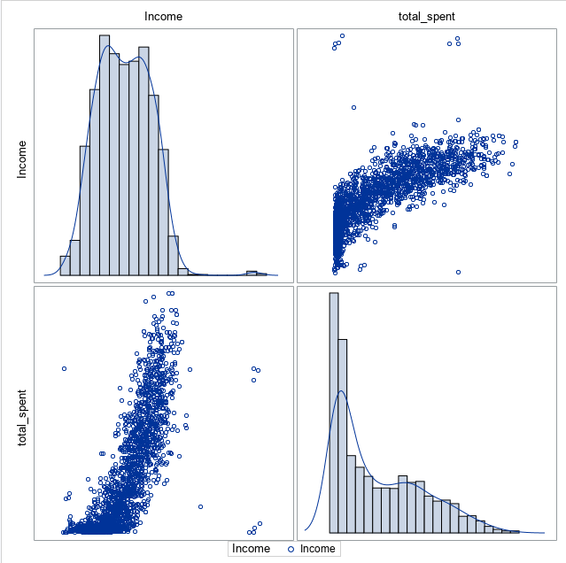
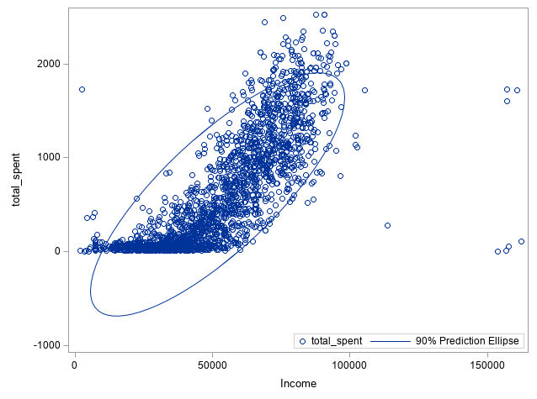
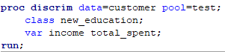
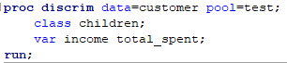
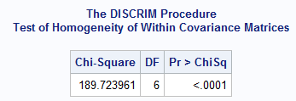
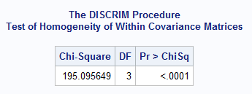
Violation of MANOVA Assumptions
The income variable does not meet the assumption of normality.
Additionally, neither children nor education satisfy the assumption of homogeneous variance-covariance.

Slide 39
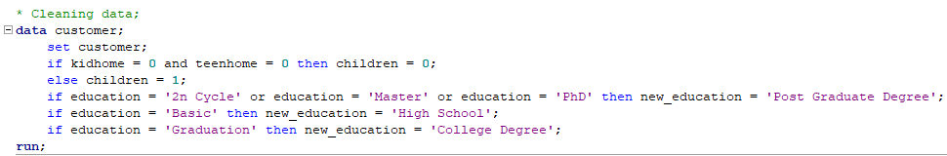
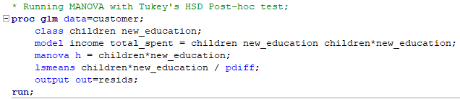
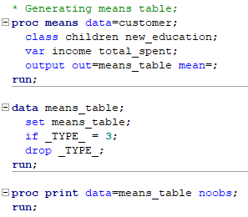
SAS Code

Slide 40
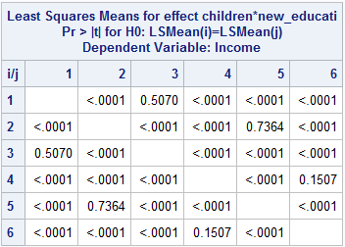
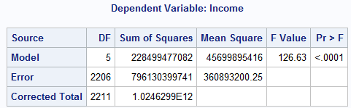
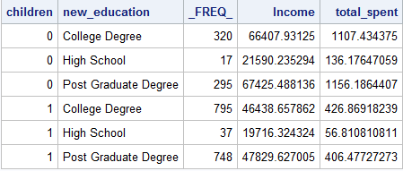
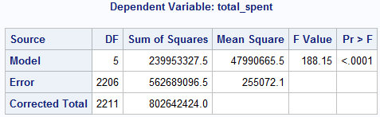
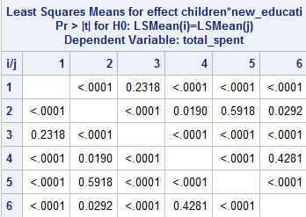
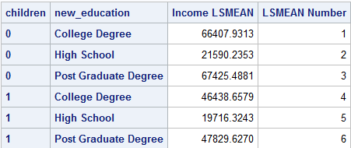
Results

Slide 41
Discussion
Low p-values for the MANOVA show that significant differences exist between our groups in both income and total spent
Tukey's HSD shows that, in particular, the difference between childless customers with a postgraduate degree and customers with a children and a high school education is significant.
The means table shows that the former make more and spend more than the latter.
Lack of multivariate normality and homogenous variance-covariance mean that these results may not be reliable.

Slide 42
Applications
We see that customers with children are likely to be on a tighter budget than those without children. Marketers can use this information to more effectively target both groups.
Similarly, if education level is known, targeted advertising can be used to advertise appropriate products to people with more and less education.

Slide 43

Our Findings + Conclusion
Notes:
SUBJECT TO CHANGE COULD DO MEAT PRODUCTS COULD DO PROMOTIONS, BASICALLY THIS CHANGES

Slide 44
Findings + Conclusion
Research Question 1 “How can we group the customers within the dataset?”
Through clustering with the interest of Income and Total Spent, we can group customers by, Children, Meat, Fish, Catalog Purchases, Total Spent, and Income.
Research Question 2 “Can we quantify the impact education and children had on income and spending?”
Through a two-way manova, we were somewhat able to support and further specify our original findings from clustering that childless customers now with a postgraduate degree versus those customers with children and a education level of high school, shows a significant difference.

Slide 45
Thank you !

